Slide 1

RailSmart – An Automated Local Railway Ticket Identification and Validation System
Group No. 12
Group members with Student Id
Tanvi Mirgal 21107028
Sakshi Jamdhade 21107042
Meghraj Padwal 21107025
Harsh Mulik 21107044
Project Guide
Ms. Rajashri Chaudhari

Slide 2
Contents
Abstract
Introduction
Objectives
Literature Review
Research Gap
Problem Definition
Scope
Technological Stack
Proposed System Architecture/Working
Prototype Design Demonstration
Implementation Status
Review Suggestions (Given in Last meeting)

Slide 3
Abstract
RailSmart aims to develop an automated railway ticket management system to streamline ticket verification, detect fraud, and issue fines efficiently. Machine learning models like TensorFlow or PyTorch will identify violations, while user registration through Flutter or React ensures secure ticket linking will manage ticket data and integrate payment gateways like Paytm and Google Pay, improving the overall efficiency and security of railway operations.

Slide 4
Introduction
The Railsmart enhances railway ticket processing with GPS-based validation, geo-fencing, and Aadhaar-linked verification for secure and efficient passenger identification.
Integrates monitoring with CCTV to detect violations and issue automated e-challans for quick enforcement.
Provides seamless payment through integrated gateways, ensuring fast and hassle-free transactions.
Offers a comprehensive dashboard with real-time insights into ticketing patterns and violations, streamlining operations and improving passenger experience.

Slide 5
Introduction
Motivation
The project aims to modernize railway ticketing by addressing challenges like large passenger volumes, compliance enforcement, and fraud reduction, which are inadequately managed by traditional manual methods.
By integratin monitoring, geofencing, and seamless payment gateways, the system automates ticket validation, enhances security, and improves the passenger experience, creating a more efficient and transparent railway network.

Slide 6
Objectives
Automate Railway Ticket Validation: Use Tesseract OCR to automate ticket scanning, improving speed and efficiency at railway stations.
Violation Detection and Fine Management: Deploy AI and machine learning to detect ticket violations and issue e-challans, tracking payments via integrated gateways.
GPS-Based Ticket Validation & Offender Detection: Implement GPS-based validation with geofencing and CCTV integration for real-time offender detection and violation tracking.
Advanced Analytics for Ticketing Insights: Create a dashboard to provide real-time analytics on ticket sales, violations, user behavior, and payment trends.

Slide 7
Literature Review
Sr.no | Title | Author(s) | Year | Methodology | Drawback
1 [1] | Indian Railways Smart Ticketing Validation System with Improved Alert Approach | Sara Navghare , Rachna . K Somkunwar, Zarina Shaikh | 2023 | The methodology involves an alert mechanism, which uses cloud-based data storage for automatic updates, minimizing operational costs, human error, and improving accuracy and timeliness. | One drawback of this system could be its reliance on internet connectivity, which may cause disruptions in validation and alerts in areas with poor network coverage.
2 [2] | Geofencing on the Real-Time GPS Tracking System | Zeynep ÖZDMIR, Bülent TUĞRUL | 2020 | This study transmits GPS data to a remote server via GSM and GPRS for real-time tracking, viewable on devices like computers and phones. To reduce GPS error, Kalman filter, logistic regression analysis, and moving average filter are used. | The potential for false alarms due to GPS inaccuracies, despite efforts to reduce the error margin with filtering techniques.
3 [3] | Android suburban railway ticketing with GPS as ticket checker | S Karthick, A Velmurugan. | 2012 | The methodology introduces an Android app for buying suburban railway tickets via QR codes. The app uses GPS to automatically validate the ticket after reaching the destination. Ticket data is stored in a cloud database. | Reliance on smartphones and GPS, which may cause issues for users without compatible devices or in areas with poor signal, potentially affecting ticket validation and usability.

Slide 8
Literature Review
Sr.no | Title | Author(s) | Year | Methodology | Drawback
4 [4] | Automated Railway Reserved Ticket Validation System | Gayathri C Loganathan P Gokul Kannan G GokulRaj V Dhineshkumar S | 2022 | The system uses QR codes for ticket validation. Each reserved ticket is issued a unique QR code, embedding the Passenger Name Record (PNR), which is scanned using high-definition cameras and processed through OpenCV. The entire system is built on Python using the Streamlit framework, | The system relies heavily on hardware like cameras and scanners, which may fail or malfunction. It doesn't include advanced security features like biometric authentication, and manual intervention.Privacy concerns also arise due to the continuous validation of personal data stored in the database.
5 [5] | Online Challan Generation System Based On Machine Learning | Dr. Sonali Ridhorkar, Khushi Gupta, Kalyani Lokhande, Prachi Bhanarkar, Vijeta Meshram, and Venuhemane | 2022 | The methodology in this paper involves developing an automated e-challan generation system using machine learning techniques.The system captures images of vehicles violating traffic rules via webcams, detects license plates using (OCR) with the help of OpenCV and Python. | Drawbacks includes reliance on webcams, which may not capture clear images in poor lighting or adverse weather conditions. Additionally, the system's accuracy is dependent on the quality of OCR, which can struggle with damaged or unclear license plates.
6 [6] | Face Recognition Smart Attendance System using Deep Transfer Learning | Khawla Alhanaee, Mitha Alhammadi, Nahla Almenhali, Maad Shatnawi | 2021 | The authors uses a facial recognition attendance system utilizing deep learning convolutional neural networks (CNN). They employ transfer learning with three pre-trained CNN models: AlexNet, GoogleNet, and SqueezeNet. | The dataset was relatively small (200 images), which might limit generalizability to larger, more diverse datasets. The training was performed on a single CPU, leading to longer training times, especially for more complex networks like AlexNet.

Slide 9
Literature Review
Sr.no | Title | Author(s) | Year | Methodology | Drawback
7 [7] | Title: E-Challan Automation for RTO using OCR | Rakesh Kumar, Meenu Gupta, Suyash Shukla, Ram Kumar Yadav | 2021 | The paper proposes using Optical Character Recognition (OCR) and image processing technology to automate the e-challan system. High-definition cameras capture vehicle number plates, and the system automatically detects violations and issues e-challans to offenders. | The system relies on timely data sharing from the RTO and may face challenges due to technical glitches, camera range limitations, and weather conditions that affect OCR accuracy.
8 [8] | Android Application for Metro Railway Ticket Booking and Checking Using QR-Code and GPS | M. Priyanka, P. Rajesh Kumar, A. P. Vamsi Krishna, P. Durga Prasad, and G. Naveen Prakash | 2020 | The methodology involves users registering on the Android app with personal details, which are stored in Firebase. The system uses GPS to track the user's location, validating the ticket by comparing their current position with predefined source and destination points. | The research paper identifies several drawbacks, including potential issues with GPS accuracy, which may lead to incorrect ticket validation in areas with poor signal coverage. Additionally, reliance on internet connectivity could cause delays or disruptions in ticket generation and validation. The security of user data, such as Aadhaar numbers, could be a concern if not adequately protected

Slide 10
Literature Review
Sr.no | Title | Author(s) | Year | Methodology | Drawback
9 [9] | Bus Tracking System using Geofencing | Amrutkar Namrata Ravindra Nikam Jayashri Rumane Mohini Patil Mohini | 2018 | The bus tracking system described in the document utilizes GPS, GSM, and geo-fencing technology to provide real-time tracking of buses. Geo-fencing is used to set geographical boundaries, and alerts are triggered when buses enter or exit these zones. The system also features real-time updates about bus locations, speeds, and estimated times of arrival. | The main drawbacks of the system include potential network failures due to GSM module issues or connectivity problems, which can affect the real-time tracking and alert system. Additionally, the system relies heavily on a stable internet connection for continuous tracking, making it less reliable in areas with poor network coverage.
10 [10] | Effective Use of Pattern Discovery for Detection of Fraudulent Patterns in Railway Reservation | Ashish Gaigowad, Prachi Deote, Prathamesh Badge, Rahul Giradkar. | 2014 | The process involves data collection from Indian Railways, integration, cleaning, reduction, and normalization of the dataset. Once pre-processed, the authors mine the data for patterns using descriptive models to identify fraudulent activities. | The study is limited to applying a specific set of techniques for fraud detection and does not compare the performance of various algorithms. The research is also dependent on the availability and quality of datasets, which can constrain its scope .

Slide 11
Research Gap(Limitations of existing systems)
Survey Analysis:
E-Challan Automation: Uses OCR for traffic violation detection, but faces data-sharing and camera accuracy issues.
Metro Ticketing (QR & GPS): Relies on GPS for validation but suffers from signal loss and network issues.
Bus Tracking (Geofencing): Tracks buses using GPS, but struggles with real-time tracking in areas with poor connectivity.
Railway Ticket Detection: Applies data mining to detect valid tickets but depends heavily on dataset quality.
How Far the Problem Is from Solved:
Accuracy Issues: Environmental factors affect OCR and GPS performance.
Data Dependency: Reliance on external data sources limits consistency.
Scalability & Security: Limited focus on scalability and concerns over data privacy in ticketing systems.

Slide 12
Research Gap(Limitations of existing systems)
Improvement Possibilities:
Accuracy: Use hybrid systems (GPS + Wi-Fi) to improve tracking reliability.
Real-time Processing: Implement redundancy or predictive algorithms to mitigate signal loss.
Scalability: Expand metro systems to other transportation modes.
Data Security: Strengthen encryption for user data.
Technologies Performing Better:
OCR Automation: Effective for task automation but needs better accuracy.
QR & GPS: Practical but requires further optimization for reliability.
Confidence in Solutions:
Proposing improved location tracking, scalability, and real-time validation solutions could effectively address existing issues.

Slide 13
Problem Definition
The current railway ticketing systems are inefficient and insecure, relying on manual validation and isolated digital solutions. These outdated methods result in long queues, frequent ticket violations, fraud, and inconsistent fine enforcement. The lack of real-time integration between passenger identification, ticket validation, and violation tracking causes operational delays and revenue losses for railway authorities.

Slide 14
Scope
Security & Law Enforcement: AI-based CCTV surveillance and real-time violation detection will identify offenders and track fare evaders, enhancing security.
Blockchain for Fine Transparency: Blockchain ensures transparency in fine issuance, allowing passengers to track fines and payments on an immutable ledger.
Revenue Management & Fine Collection: Automated fine issuance and integrated payment gateways streamline fine collection, reducing revenue loss from unpaid violations.
Custom Alerts: Data analytics provide automated alerts to ticket checkers about high-risk passengers, improving validation security.

Slide 15
Technological Stack
Front-End Technologies: Flutter / React
Back-End Technologies: Node.js with Express.js
Database Technologies: MongoDB
Image Processing and OCR: Tesseract OCR/Google Cloud Vision API
AI and Machine Learning: TensorFlow / Py Torch
CCTV Integration: OpenCV
Payment Gateway Integration: Razor pay / Paytm / Google Pay
Data Visualization and Analytics: Power BI

Slide 16
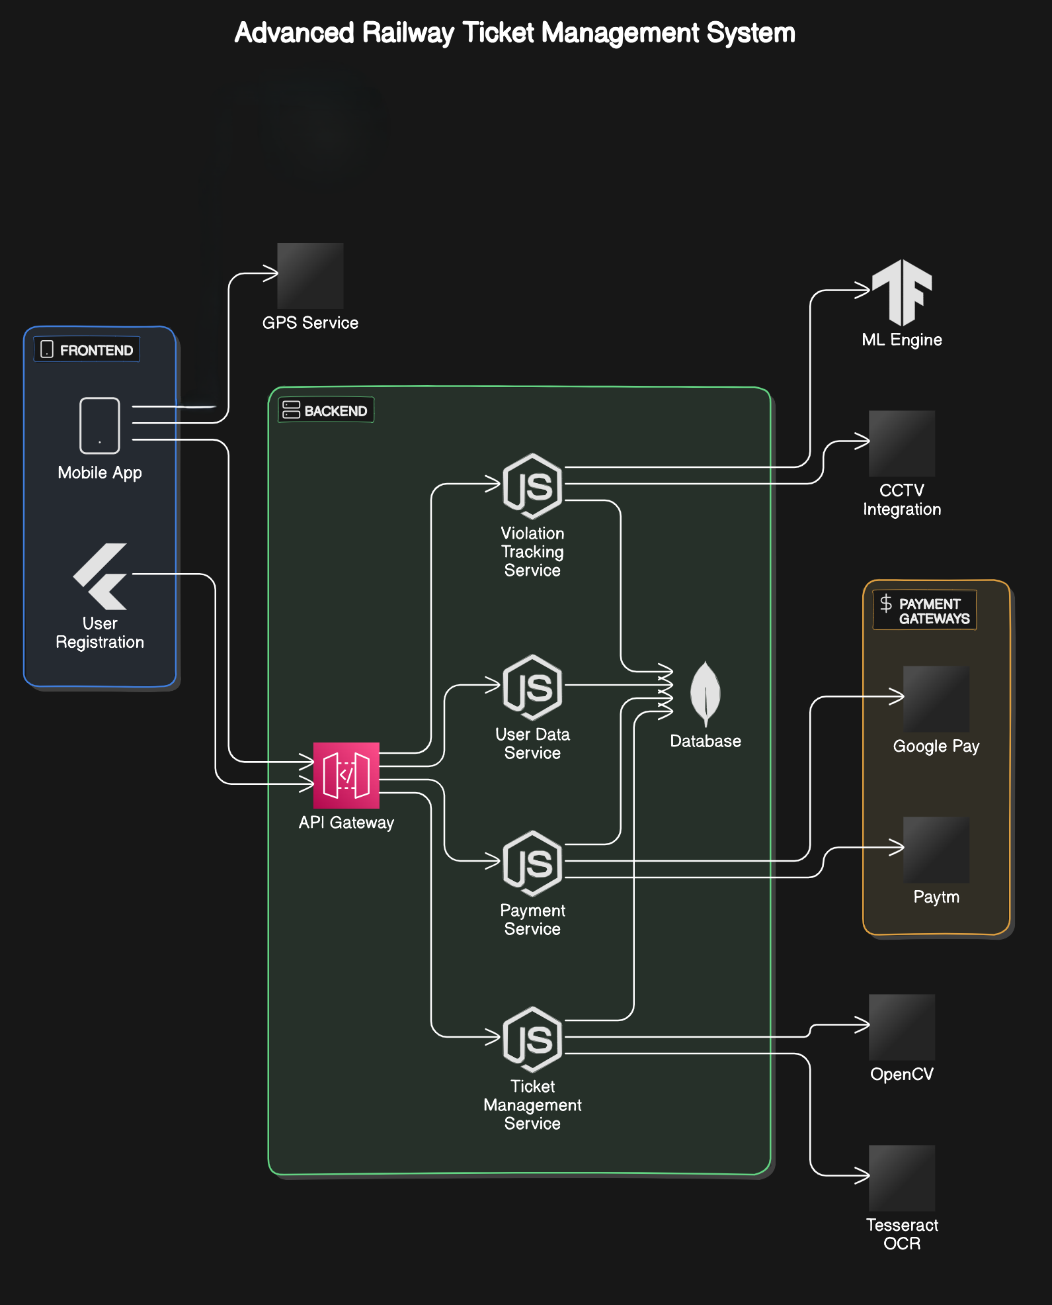
Proposed system architecture/Working

Slide 17
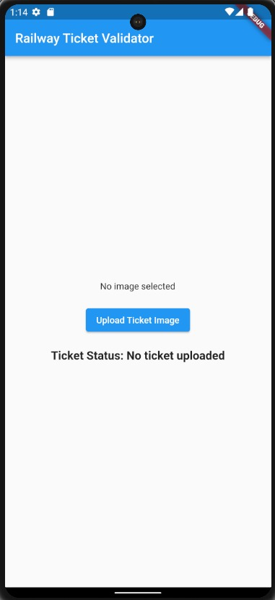
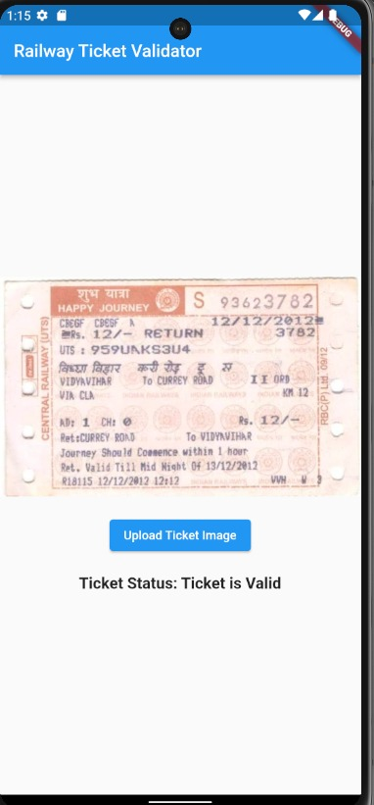
Prototype Design Demonstration

Slide 18
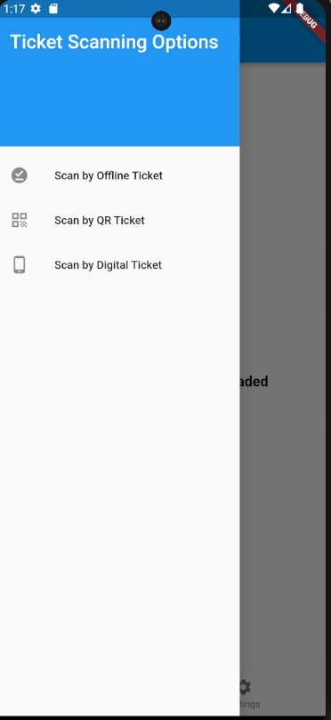
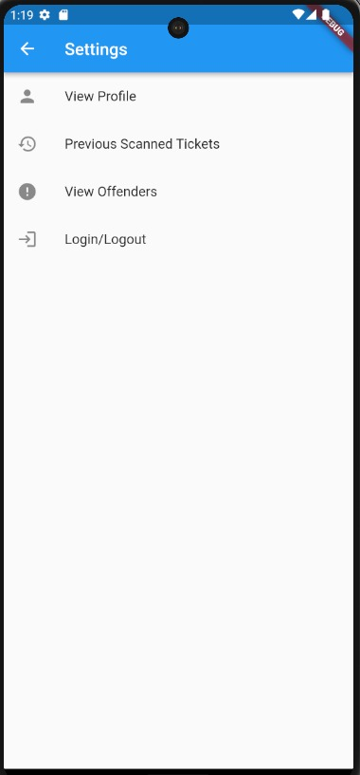
Prototype Design Demonstration

Slide 19
Implementation Status
Completion of First Objective: The first major objective of the project has been successfully completed, which involved the development and integration of the primary mobile application frontend.
30% of Base Project Ready: Approximately 30% of the base project is complete, which includes core modules and basic functionality.
Mobile Application Frontend/Backend Development: The initial version of the mobile app frontend/backend is ready, covering essential design and user interactions.

Slide 20
Review Suggestions (Given in Last meeting)
Not Applicable for Review 1

Slide 21
References
[1] S. Nawghare, R. K. Somkunwar and Z. Shaikh, "Indian Railways Smart Ticketing Validation System with Improved Alert Approach," 2023 International Conference on Sustainable Computing and Smart Systems (ICSCSS), Coimbatore https://ieeexplore.ieee.org/document/10169786
[2] Z. ÖZDEMİR and B. TUĞRUL, "Geofencing on the Real-Time GPS Tracking System and Improving GPS Accuracy with Moving Average, Kalman Filter and Logistic Regression Analysis," 2019 3rd International Symposium on Multidisciplinary Studies and Innovative Technologies (ISMSIT), Ankara, Turkey https://ieeexplore.ieee.org/document/8932766
[3] S. Karthick. and A. Velmurugan., "Android suburban railway ticketing with GPS as ticket checker," 2012 IEEE International Conference on Advanced Communication Control and Computing Technologies (ICACCCT), Ramanathapuram, India https://ieeexplore.ieee.org/abstract/document/6320742

Slide 22
References
[4] Gayathri C., Loganathan P., Gokul Kannan G., GokulRaj V., Dhineshkumar S. (2022). "Automated Railway Reserved Ticket Validation System." International Journal of Research in Engineering and Science (IJRES).chrome-extension://efaidnbmnnnibpcajpcglclefindmkaj/https://www.ijres.org/papers/Volume-10/Issue-5/Ser-6/H10056065.pdf
[5] Ridhorkar, S., Gupta, K., Lokhande, K., Bhanarkar, P., Meshram, V., & Venuhemane. (2022). "Online Challan Generation System Based On Machine Learning." International Journal of Innovations in Engineering and Science, 7(8), 120-125. https://doi.org/10.46335/IJIES.2022.7.8.22
[6] Alhanaee, K., Alhammadi, M., Almenhali, N., & Shatnawi, M. (2021). Face Recognition Smart Attendance System using Deep Transfer Learning. Procedia Computer Science, 192, 4093–4102. https://www.sciencedirect.com/science/article/pii/S1877050921019232
[7] Kumar, R., Gupta, M., Shukla, S., & Yadav, R. (2021). E-Challan Automation for RTO using OCR. Proceedings of the Third International Conference on Inventive Research in Computing Applications (ICIRCA), 2021, IEEE. https://ieeexplore.ieee.org/document/9545082

Slide 23
References
[8] Android Application for Metro Railway Ticket Booking and Checking Using QR-Code and GPS, Sri Anjali Devi G, Vandana K, Mahalaxmi U, 2019 chrome-extension://efaidnbmnnnibpcajpcglclefindmkaj/https://www.rsisinternational.org/journals/ijrsi/digital-library/volume-6-issue-5/77-80.pdf
[9] Amrutkar, N. R., Nikam, J., Rumane, M., & Patil, M. (2018). Bus tracking system using geofencing. International Journal of Research in Engineering, Science and Management chrome-extension://efaidnbmnnnibpcajpcglclefindmkaj/https://www.ijresm.com/Vol_1_2018/Vol1_Iss12_December18/IJRESM_V1_I12_198.pdf
[10] Gaigowad, A., Deote, P., Badge, P., & Giradkar, R. (2014). Effective use of pattern discovery for detection of fraudulent patterns in railway reservation. International Journal of Computing and Technology https://www.ijcat.org/IJCAT-2014/1-1/Effective-Use-of-Pattern-Discovery-for-Detection-of-Fraudulent-Patterns-in-Railway-Reservation.pdf

Slide 24
Thank You...!!

